Slide 1
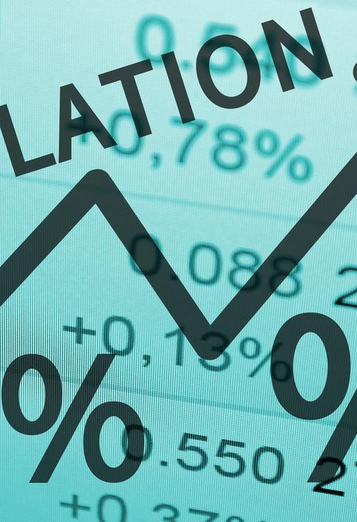

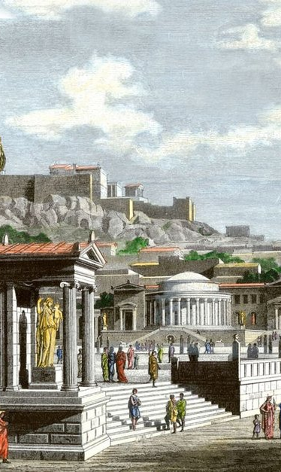
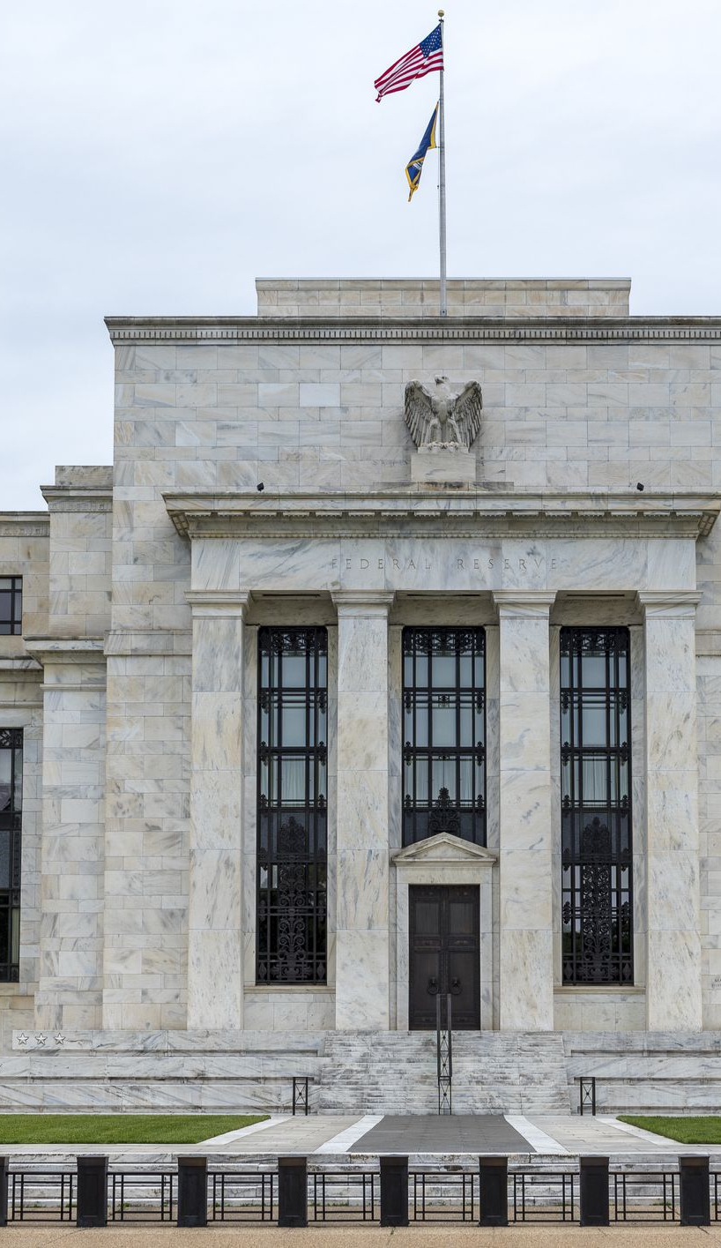


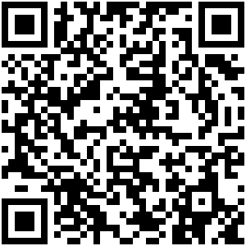
Secrets of the Temple or Noise of the Agora?
The political and financial implications of the communicative turn in central banking
Moritz Pfeifer (CRPM Nanterre and SciencesPo Paris)
Mohamed El Guindi (HEC and SciencesPo Paris)
Giancarlo Salazar-Caicedo (independent researcher, econometricus.com)

Slide 2
1. Executive summary
HYPOTHESIS
JUSTIFICATION
METHOD
The switch towards a transparency regime has made the Federal Reserve communication a key instrument not only to increase monetary policy efficiency, but also to build trust
The communicative challenge of the Federal Reserve comes from the heterogeneity of its audiences:
Audience of the FED is not limited to the markets
Audiences are not equally receptive
Can the FED increase the efficiency of monetary policy transmission, and rebuild trust, by tailoring its communication to the different audiences?
Analyzing the history of the Federal Reserve reveals that it is at the center of a conflict between four audiences: the government (State), households, and banks (financial institutions)
The Keynesian framework distinguishes between:
Short term rate set by monetary authority
Long term rates determined by liquity preferences of different actors in the economy
The FED’s history and Keynes’ theory of interest rate allows us to analyze four distinct audiences: government, households, banks and firms
We created a new database that encompasses 50 years of speeches by the Board of Governors and Regional Bank presidents from the Great Inflation to the Post-Financial Crisis era
We use a new method to analyze different FED communications by devising audience-specific dictionnarie based off which tone scores are computed, and adapting optimal Taylor rule interest rates to different audiences
We use Arranged Local Regressions to perform a quantitative analysis of central bank communication by estimating a variable coeeficient model

Slide 3
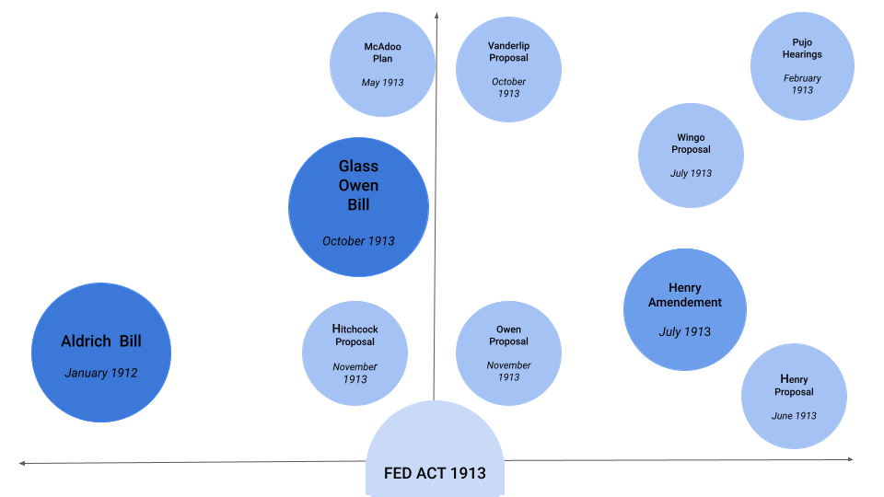
2. The Federal Reserve Act 1913: A Clash of Audiences
THE CONFLICTUAL PATH TO THE FEDERAL RESERVE ACT OF 1913
AUDIENCES AND THE FED
GOVERNMENT
The creation of the Federal Reserve is the result of a compromise between three audiences that mutually distrusted each other
First fundamental mistrust between markets and the general public:
The public blamed speculation as a cause of economic crises
Bankers distrusted the public in the name of technocracy
Second fundamental mistrust between the state and markets:
Bankers feared FED would turn into a political bank
Government distrusted banks fearing the the creation of a monopoly
BANKS
GENERAL PUBLIC

Slide 4
3. The FED and the Public during the Great Financial Crisis: Déjà-vu
MARKET VS STATE
MARKET VS PUBLIC
PUBLIC VS STATE
Political Intervention vs Market Monopoly
Speculative Excess vs
Technocratic Legitimacy
Governmental Oversight and
Weight of Public Opinion
The General Public blamed speculation as a cause of economic crises
Bankers distrusted the public in the name of technocracy
The General Public blamed speculation as a cause of economic crises
Bankers distrusted the public in the name of technocracy
1913
Bankers feared it would turn into a political bank
Government also distrusted banks feared the creation of a monopoly
Government Control vs
Irresponsible Behaviour
Speculative Excess vs Focus on Profits
Policy and bailout criticism vs
Secrecy of programmes
Bankers feared governmental intervention and control over shares and operations
Government was frustrated by pre-crisis behavior and post-bailout scandals
The Public blamed the Government for higher inequality (L) / policy blunders (R)
Government delayed details of bailouts to avoid backclash , displaying lack of trust
The public saw banks as symbolizing inequality (L)/underservedly bailed out (R)
Banks in turn only focused on profit rather than helping the public
2008

Slide 5
4. Communication and the Long Term Optimal Rate in Keynesian Theory
KEYNESIAN FRAMEWORK
DETERMINING THE INTEREST RATE IN KEYNESIAN THEORY
“In Keynes’s view the essential task of macroeconomics was to explain how markets do and do not coordinate the diverse behaviors of agents: households and firms, savers and investors, workers and employers, creditors and debtors, bulls and bears, citizens and governments. To assume away this diversity is to default the responsibilities of the profession to maintain seriousness and relevance.”
- James Tobin, “The Invisible Hand in Modern Macroeconomics” (1991)
Monetary Authority
Short term rate
Long Term Rate
Firms
Banks
Government
Households
The natural rate in the Taylor Rule model is the interest rate that balances savings and investment – it is assumed to be the policy target of central banks (New Consensus Macroeconomics Framework)
While the “short-term rate of interest is easily controlled by the monetary authority” (Keynes 1936: 203), the challenge of monetary policy lies in guiding financial conditions to the investment decisions of nonfinancial borrowers by looking at changes in interest rate spreads.
Not one “conventional” rate, but several rates which depend on psychological factors (confidence, animal spirits, etc.). Communication may thus be a more important tool in managing expectations than interest rate setting.
If the long-term interest rates are too high relative to the “optimum rates”, firms and households may need additional convincing to accept the higher interest rates the market has to offer.

Slide 6
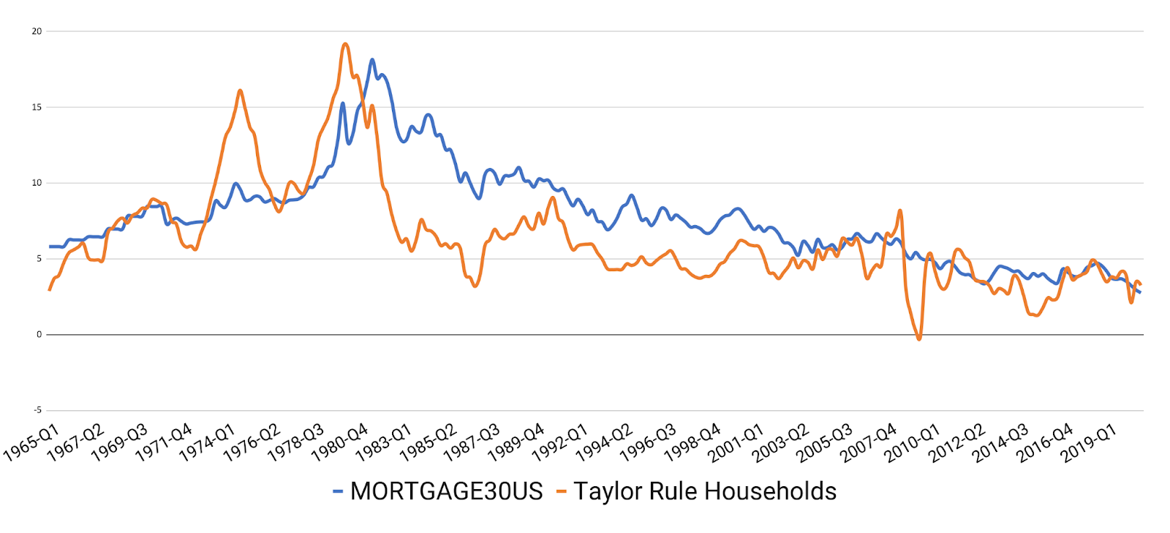
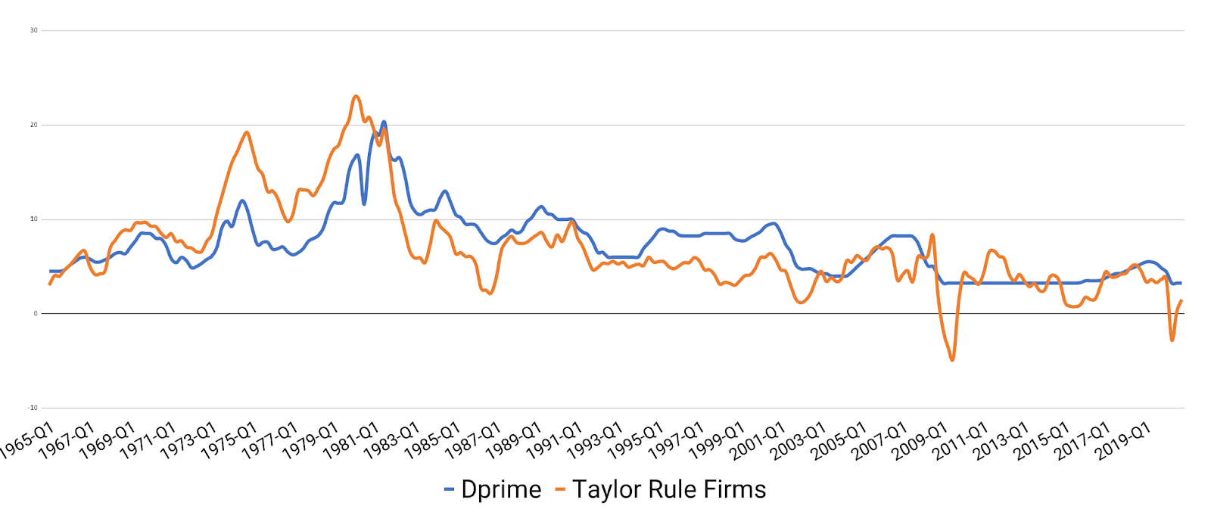
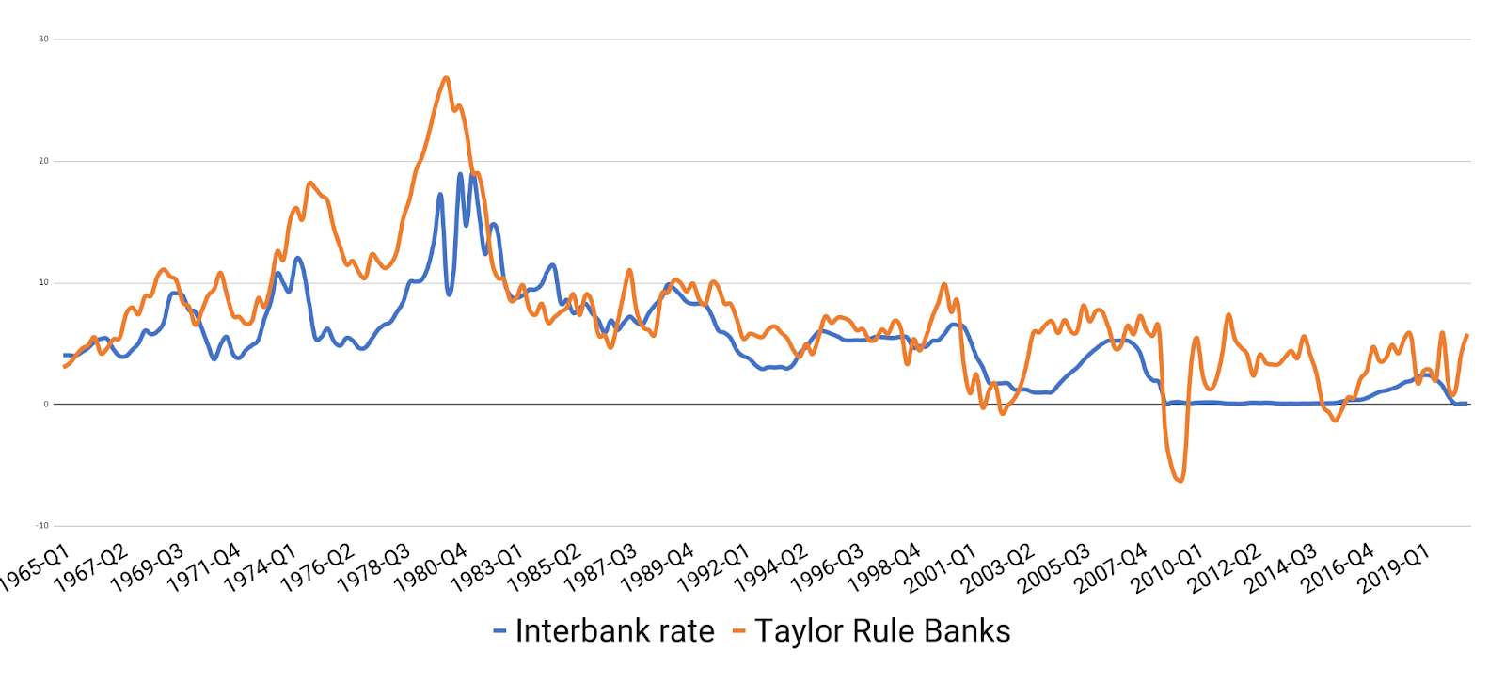
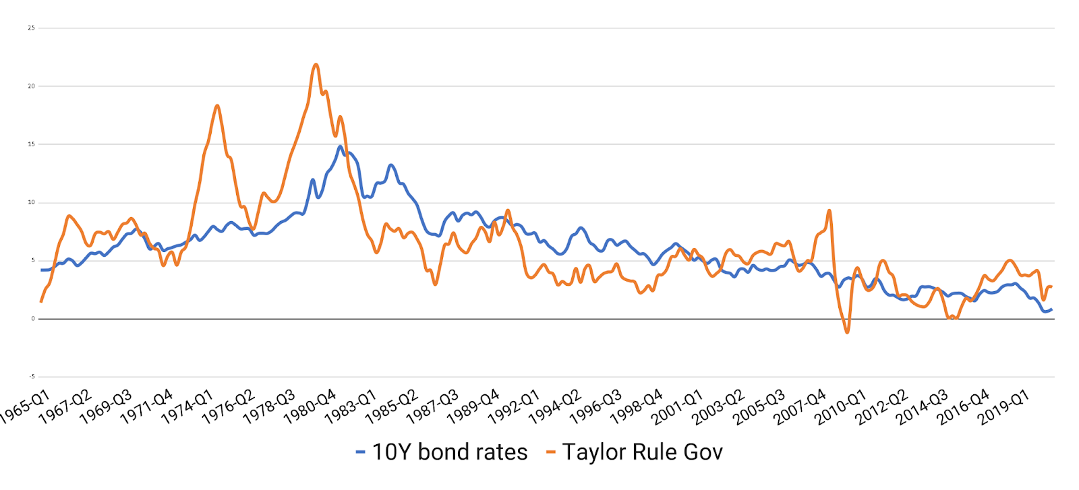
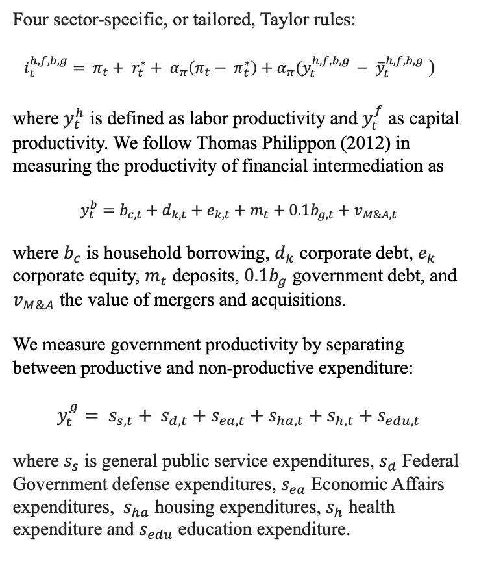
5. Taylor Rule Optimal Interest Rates Adapted to Difference Audiences
TAILORED TAYLOR RULES
GAP BETWEEN OPTIMAL AUDIENCE RATE AND ACTUAL MARKET RATE
HOUSEHOLD TR VS MORTAGE RATE
FIRM TAYLOR RULE VS PRIME RATE
Four sector-specific, or tailored, Taylor rules:
$i_{t}^{h,f,b,g}= π_{t}+ r_{t}^{∗}+ α_{π}\left(π_{t}− π_{t}^{∗}\right)+α_{π}(y_{t}^{h,f,b,g }− {\overline{y}}_{t}^{h,f,b,g}$ )
where $y_{t}^{h}$ is defined as labor productivity and $y_{t}^{f}$ as capital productivity. We follow Thomas Philippon (2012) in measuring the productivity of financial intermediation as
$$y_{t}^{b}=b_{c,t}+d_{k,t}+e_{k,t}+m_{t}+0.1b_{g,t}+v_{M\&A,t}$$
where $b_{c}$ is household borrowing, $d_{k}$ corporate debt, $e_{k}$ corporate equity, $m_{t}$ deposits, $0.1b_{g}$ government debt, and $v_{M\&A}$ the value of mergers and acquisitions.
We measure government productivity by separating between productive and non-productive expenditure:
$$y_{t}^{g}= s_{s,t}+ s_{d,t}+s_{ea,t}+s_{ha,t}+s_{h,t}+s_{edu,t}$$
where $s_{s}$ is general public service expenditures, $s_{d}$ Federal Government defense expenditures, $s_{ea}$ Economic Affairs expenditures, $s_{ha}$ housing expenditures, $s_{h}$ health expenditure and $s_{edu}$ education expenditure.
BANKS TR VS INTERBANK RATE
GOVERNMENT TR VS BOND RATE

Slide 7
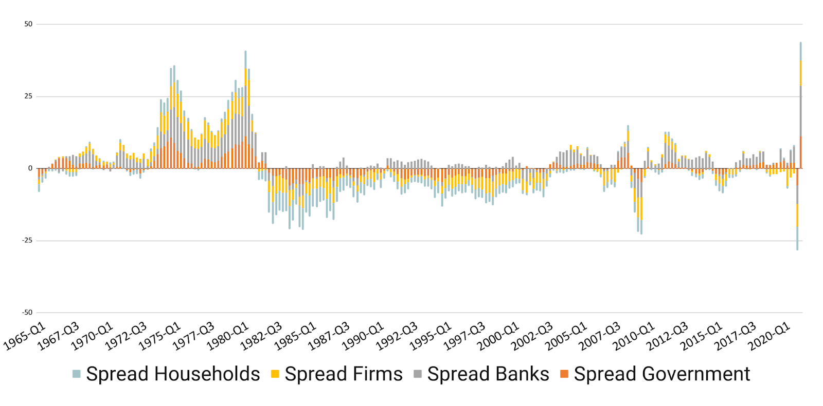
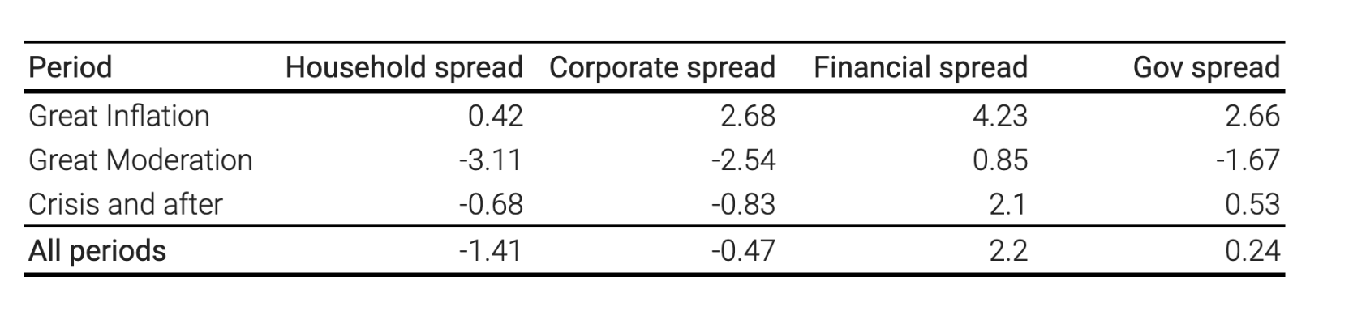
6. Analyzing the Taylor Rule Spreads and their Significance
TAYLOR RULE SPREADS
On the one hand, the spread represents the gap that the Fed’s communication is supposed to solve for, and, on the other hand, the variation of the spread shows the degree of success/failure of the Fed in its communicative effort.
A marked periodic difference can be observed between the seventeen years of the Great Inflation and the Great Moderation (1983Q1-2007Q2), where the spreads turn negative, i.e. higher than the optimal rate, for all sectors except banks.
A structural break in the data (Chow 1960) can be observed in 1982 which marks the end of the Great Inflation and the beginning of the Great Moderation. Only the household data indicates a pattern that is significantly different before and after that period.
How “moderate” is the great moderation if we look at the spreads?
Both households and firms continue to have market rates that are above their optimal rate for the period of the financial crisis and after (2007Q3-2020Q4). The financial sector is the only sector whose rates are consistently below their optimal level. Public sector has regained some ground after the great moderation.

Slide 8
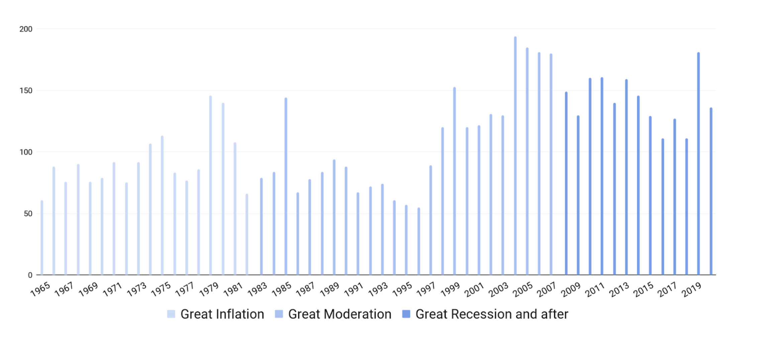
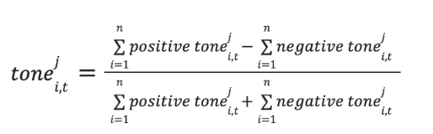
7. Data Collection and Empirical Methodology
DATA COLLECTION
AUDIENCE-SPECIFIC DICTIONARIES
We created four different dictionaries, each dictionary representing a different audience group. The dictionary specific-audiences are the bank, the firms, the government and the households, accounting.
We used w-shingling to generate a list of n-grams that occur in the speeches of the dataset, and obtain the number of occurrences of each.
Having done this, we manually selected the n-grams and classified them into the different audience-based dictionaries, which allowed us to contextualize the different n-grams and verify their significance.
We have collected , through various web scrapping tools, 56 years (1965Q1 – 2020Q4) of public documents from the Federal Reserve
2328 speeches made by the Board of Governors
2459 speeches made by the twelve regional bank presidents
MEASURING TONE OF SPEECHES
To quantify the tone of each communication, we follow the standard practice and use an automated linguistic text approach. This process searches each of the 4787 speeches and interviews for words and counts the number of positive or negative words in each speech.
The value measuring the tone of each speech and interview is calculated with the following formula for each dictionary:

Slide 9
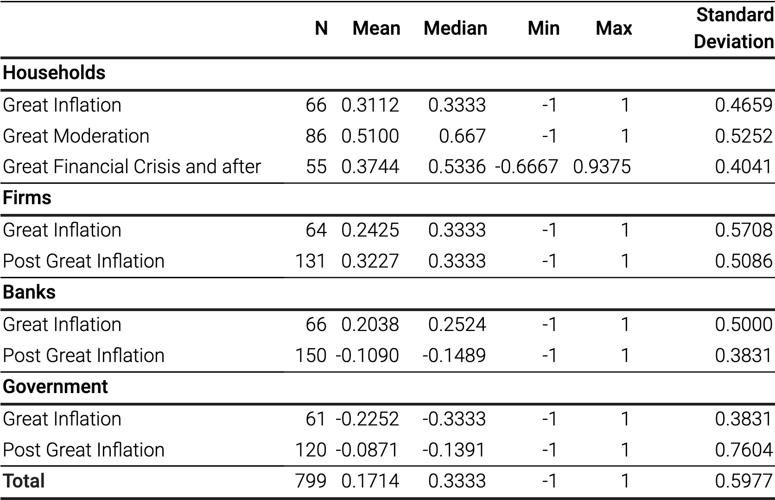
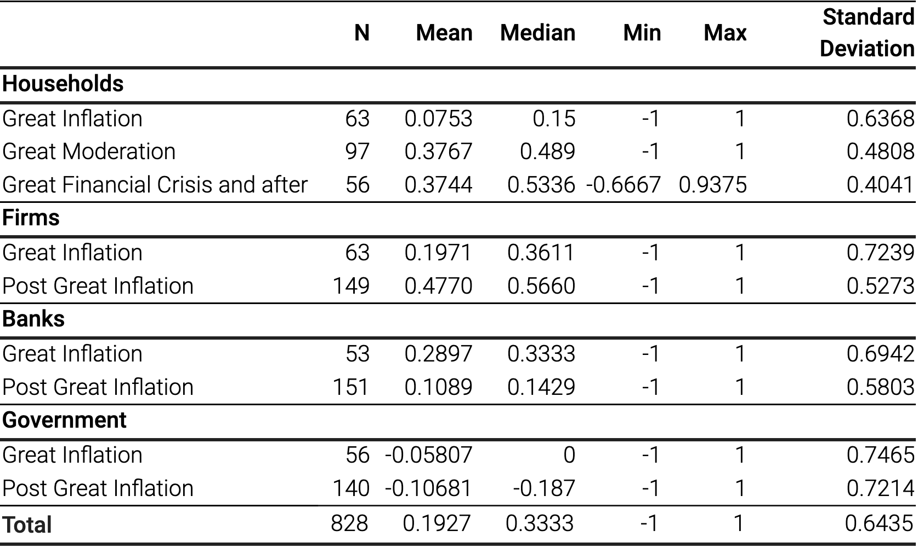
8. Tone Score Results and Implications for our Study
SPREAD BETWEEN OPTIMAL RATE AND MARKET RATE
TONE SCORES PER AUDIENCE FOR BOARD OF GOVERNORS
TONE SCORES PER AUDIENCE FOR REGIONAL PRESIDENTS
Hypothesis: if communication is a matter of convincing different economic actors to move closer to their optimal rate, then the relationship between central bank communications and the spreads can be expected to be negatively correlated in an environment where the spreads are positive, and positively correlated in an environment where the spreads are negative.

Slide 10
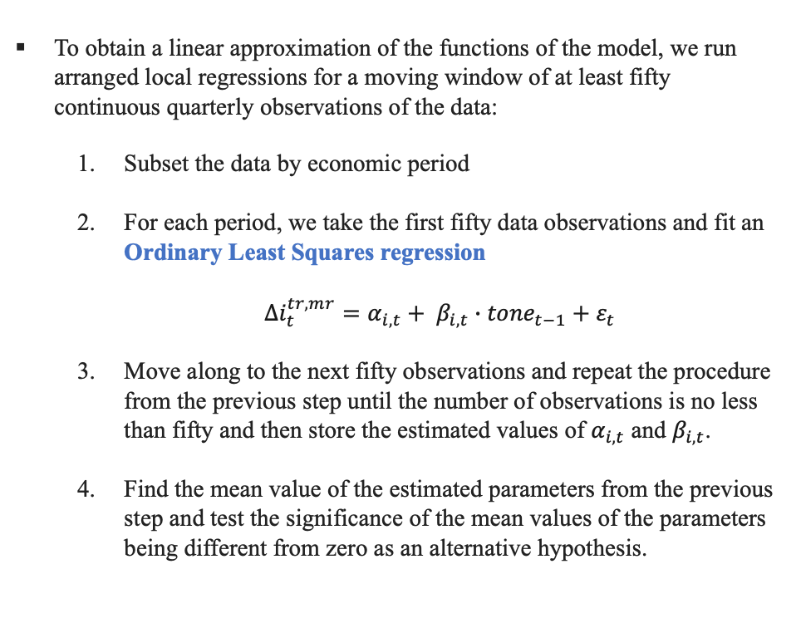
9. Econometric Methodology
ALR MODELING FOR VARIABLE COEFFICIENTS
ESTIMATING THE PARAMETERS OF THE REGRESSION
As observed in Figure 6, a structural break in the data can be observed in 1982 which marks the end of the Great Inflation and the beginning of the Great Moderation.
Thus the estimated coefficients cannot be assumed to be constant over the entire period.
To account for variable coefficients, we estimate a variable-coefficient model via an Arranged Local Regression (ALR), we specify the model as the following: where the spread at time i depends on the lagging value of the tone of the position j at time i, for which the period is a categorical variable with either three or two values, while the position j is a categorical binary variable.
To obtain a linear approximation of the functions of the model, we run arranged local regressions for a moving window of at least fifty continuous quarterly observations of the data:
Subset the data by economic period
For each period, we take the first fifty data observations and fit an Ordinary Least Squares regression
${Δi}_{t}^{tr,mr}=α_{i,t}+ β_{i,t}∙{tone}_{t−1}+ε_{t}$
Move along to the next fifty observations and repeat the procedure from the previous step until the number of observations is no less than fifty and then store the estimated values of $α_{i,t}$ and $β_{i,t}$.
Find the mean value of the estimated parameters from the previous step and test the significance of the mean values of the parameters being different from zero as an alternative hypothesis.
$${(Δi}_{t}^{tr,mr}\text{|}{tone}_{i, t−1}^{j}=f\left({Period}_{t}\right)+f\left({Position}_{t} ∙{tone}_{t−1}\right)+ε_{t}$$

Slide 11
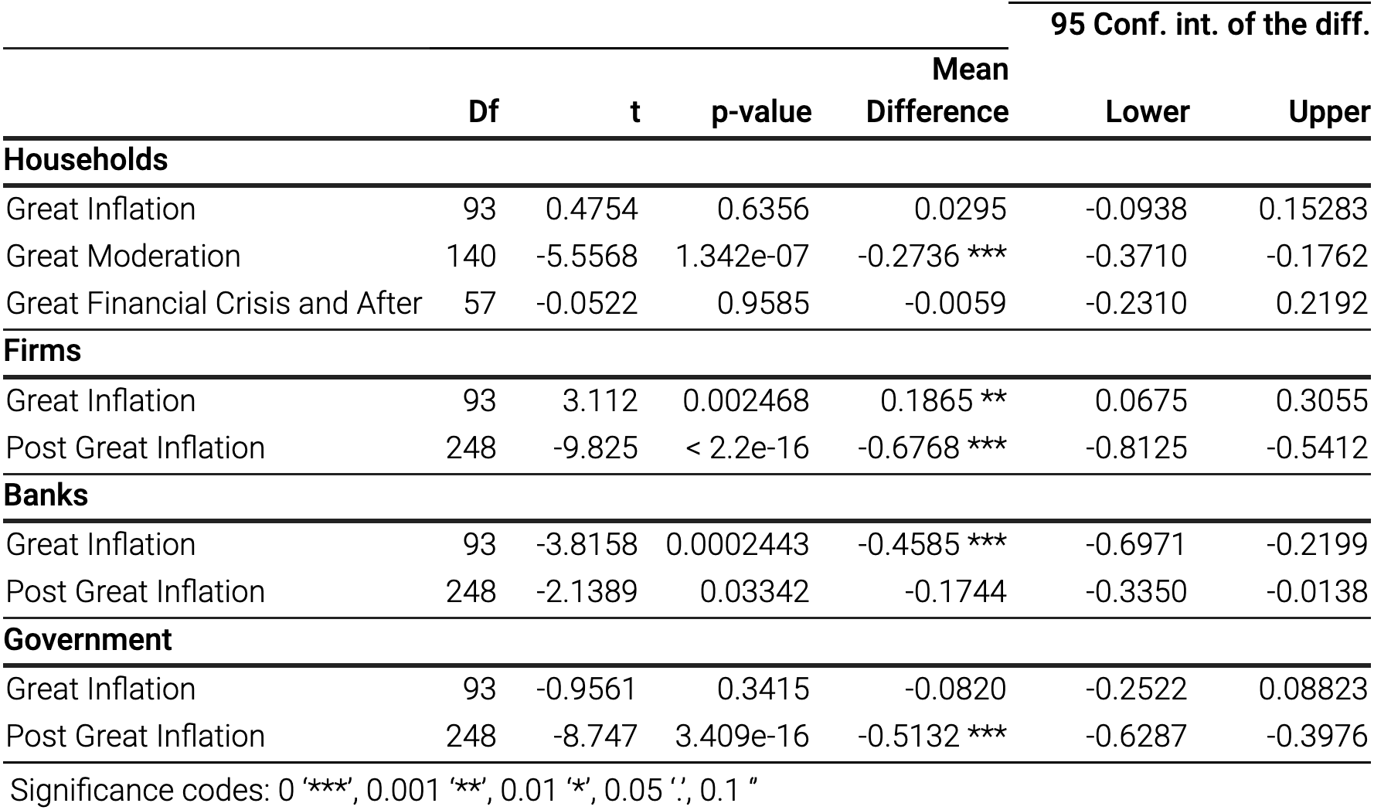
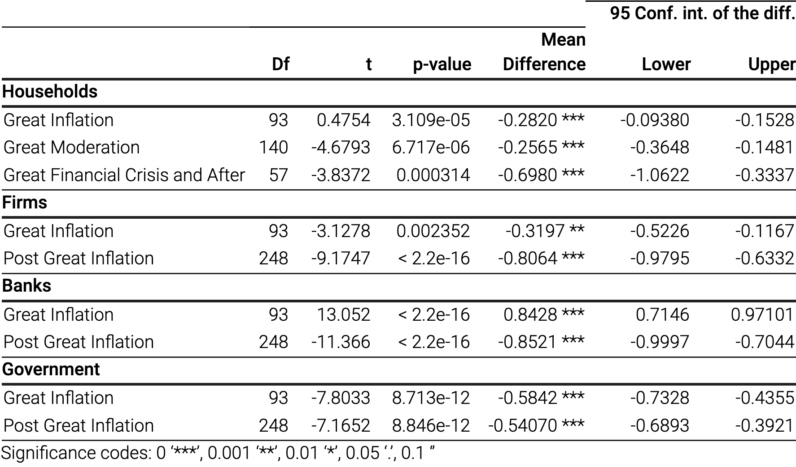
10. Empirical Findings (1 of 2)
REGRESSION RESULTS
REGRESSION RESULTS FOR BOARD OF GOVERNORS
REGRESSION RESULTS FOR REGIONAL PRESIDENTS
The coefficients between the board of governors and regional bank presidents are only different in magnitude except for the financial sector and for firms during the Great Inflation. That means that, regardless of whether communications are efficient and trustworthy, central bankers’ communications are overall coherent on the regional and federal levels.
With the sole exception of speeches directed at households during the Great Moderation, the coefficients of the regional bank presidents are all higher, however, which means that their communications seem to drive the spreads to a larger extent than those of the board of governors.

Slide 12
11. Empirical Findings (2 of 2)
FINANCIAL AND POLITICAL IMPLICATIONS
During the Great Inflation, the spreads for all sectors for that period were positive. We would thus expect the coefficient to be negative, as the tone will then reduce the spread. This result is confirmed for the Great Inflation. Two exceptions: board of governors seem to be positively biased towards firms and the regional presidents towards banks.
Differences between the regional bank presidents and the board of governors during the Great Inflation, could be an indication for a more confrontational attitude. The Fed did not appear to communicate with one voice on these issues with speeches serving the purpose of debating decisions about which people might reasonably disagree.
RESULT 1
Our research indicates a negative bias towards households, firms and the government and a positive bias towards the financial sector that started in the 1980s and has never changed since.
The biases confirm some of the historic tensions surrounding the creation of the Federal Reserve system with the early 1980s marking a reshuffling of the balance of power away from producers and consumers – monetary policy favouring debtors including the government – towards the financial sector – monetary policy favouring creditors.
RESULT 2
The financial implications of these biases can be further analysed with regards to the Fed’s mandate of promoting moderate long-term rates. As we have shown, this goal has been missed once long-term rates are understood as sector-specific optimal rates. This makes communications necessary for an efficient management of long-term rates. Most importantly, communications can facilitate the translation of the short-term rate set by the central bank into optimal market rates.
The political implications suggest that targeted communications may be more efficient and more trustworthy even in the presence of disagreement among regional and federal central bankers than communications that try to “speak with one voice”. During the Great Inflation our data indicates that the central bank appears to be able to successfully narrow the spread by directing communications at the respective audiences.
RESULT 3

